Slide 1
1. Understanding the Data
Jumlah penjualan pizza
Tipe pizza (Nama pizza, category, ingredient)
Harga pizza
Ukuran pizza
Date and Time purchase/pembelian
Order details
2. Defining Problem Statement
Bagaimana caranya meningkatkan revenue product, 5% dalam waktu 1 Quartal kedepan.
3. Making Issue Tree
Determine best – revenue pizza category and size
Capitalize best selling product
Bagaimana caranya meningkatkan revenue product, 5% dalam waktu 1 Quartal kedepan.
Determine best bundling combination between best and worst selling product
Determine best time and worst time
Improve Operational Efficiency
Best targeted customer
Meningkatkan Layanan

Slide 2
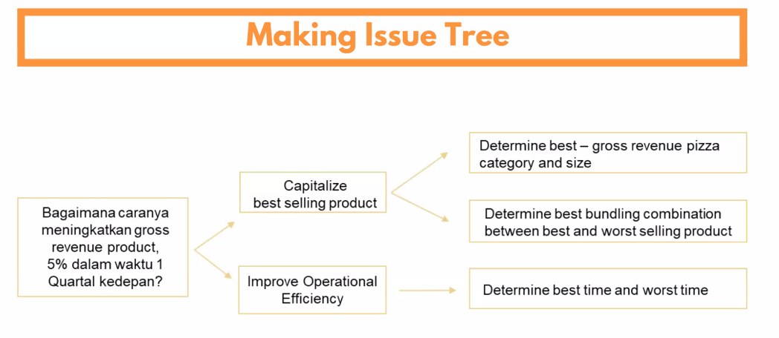
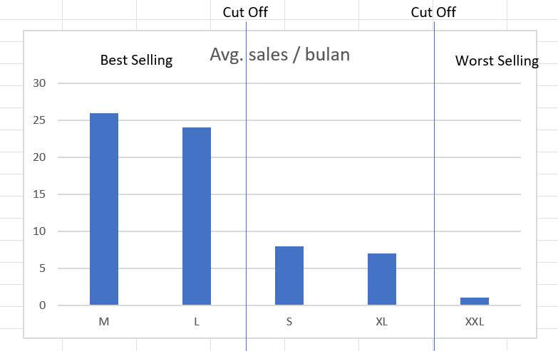
Hyphothesis
Metrics
- Harga Pizza
- Pizza ID
- Pizza category
- Ukuran Pizza
Avg. Revenue from Pizza Category / Month. – 6%
Avg. Revenue from Pizza Size / Month. - 7%
Dengan memfokuskan strategi pemasaran pada best selling product, maka revenue akan naik sebanyak 5% dalam 1 Quartal kedepan.
Dengan melakukan strategi bundling, maka revenue overall kita bisa naik 5% dalam 1 Qurtal kedepan.
- Harga Pizza
- Pizza ID
- Pizza Category
- Ukuran Pizza
- Tagging best/worst selling product
Total order per pizza per Bulan:
Level Ukuran
Level Category
Level Pizza Type ID
Paket Hemat: Ukuran M dan L
Metrics: Avg. Revenue from Paket Hemat / Month = 7%
09 – 15 , 15 – 18, 18 - 21

